Slide 1
Linear Regression
INTRODUCTION TO MACHINE LEARNING
- Shikha Singh

Slide 2
Linear Regression
Linear Regression is a machine learning algorithm based on supervised learning.
In statistics, linear regression is a linear approach to model the relationship between a dependent variable and one or more independent variables.

Slide 3
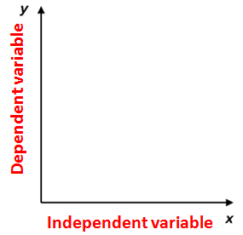
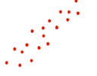
Linear Regression
X- independent variable
Y- dependent variable
This regression technique finds out a linear relationship between x (input) and y(output).

Slide 4
Linear Regression
Regression techniques mostly differ based on the number of independent variables and the type of relationship between the independent and dependent variables.
Number of independent variables
1. Simple regression 2.Multiple linear regression

Slide 5
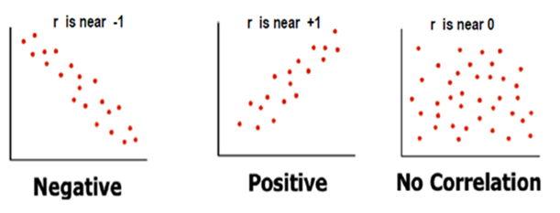
Linear Regression
Degree of relationship between the attributes Y and X
Mathematically correlation between two variables indicates how closely their relationship follows a straight line.
We use Pearson’s correlation which ranges between -1 and +1.

Slide 6
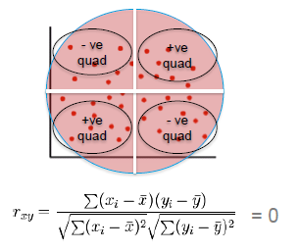
Linear Regression
Coefficient of correlation [Pearson’s coefficient]
p(x,y) = Cov(x,y) / ( stndDev (x) X stndDev (y) )

Slide 7
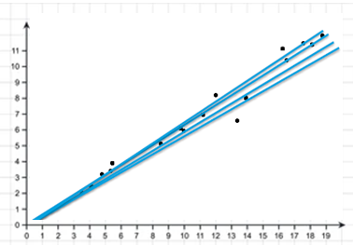
Linear Regression
The scatter plot below shows apparent correlation between X and Y.
But there are infinite number of lines that can fit in the scatter. Which one should we consider as the model?
We use gradient descent method for finding the best model which uses partial derivatives on the parameters (slope and intercept) to minimize sum of squared errors

Slide 8
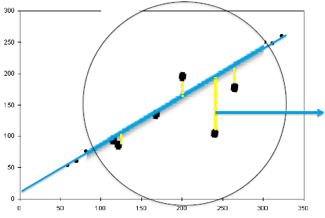
Linear Regression
The distance between a actual point and the predicted line (drop a line vertically (shown in yellow)) is the error in prediction.
That line which gives least sum of squared errors is considered as the best line
Error in prediction

Slide 9
Linear Regression
Evaluation in regression
Evaluation metrics are a measure of how good a model performs and how well it approximates the relationship.
The most common metric for simple linear regression tasks are MSE, MAE, R-squared.

Slide 10


Mean Squared Error
Steps –
Find the difference between the actual y and predicted y value, for a given x.
Square this difference.
Find the mean of the squares for every value in X.
Mean Absolute Error (MAE)
This is simply the average of the absolute difference between the target value and the value predicted by the model.

Slide 11
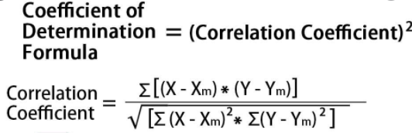
Linear Regression
This coefficient of determination is commonly known as R-squared (or R²), and is sometimes referred to as the "goodness of fit.“
The closer the value tends to 1, the better the model is!
The value of R² ranges from 0 to 1, that it: 0 < R² < 1

Slide 12
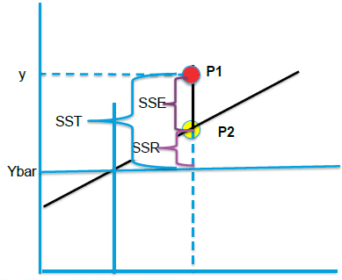
Simple Linear Regression
There r basically 2 types of errors stochastic as well as deterministic errors
Let’s consider this model below to understand these errors!!
P1 –Actual y data point for given x
P2 -Predicted y value for given x
Ybar–Mean of all Y values in data set
SST –Sum of Square error Total
Variance of P1 from Ybar(Y –Ybar)^2
SSR -Regression error (p2 –ybar)^2
SSE -Residual error (p1 –p2)^2
Xbar
x

Slide 13
Simple Linear Regression Models
That model is the most fit where every data point lies on the line. i.e. SSE = 0 for all data points
Hence SSR should be equal to SST i.e. SSR/SST should be 1.
Poor fit will mean large SSE. SSR/SST will be close to 0
SSR / SST is called as r^2 (r square) or coefficient of determination

Slide 14
Thankyou!!☺

